Slide 1


Kanya Mahavidyalaya
Kharkhoda
PRESENTATION OF
DATABASE MANAGEMENT SYSTEM
Presented By:
Mrs.Nisha Suhag

Slide 2
DATABASE : A collection of data is referred to as database. e.g. 1. record of students stored in files
2. information stored over internet
DATABASE MANAGEMENT SYSTEM: It is basically a computer based record keeping system (program).
e.g. MySQL
Microsoft Access
FileMaker
FoxPro

Slide 3
Purpose of database :
1. It reduces DATA REDUNDANCY to a large extent.
2. It controls DATA INCONSISTENCY.
3. It facilitate SHARING of data.
4. It ensures DATA SECURITY.
Data Redundancy Data Inconsistency
Name | DOB | Fees
Harsh | 23/1/1993 | Not Paid
Amar | 4/11/1994 | Paid
Devendera | 14/6/1992 | Not Paid
Harsh | 23/1/1993 | Not Paid
Name | DOB | Fees
Harsh | 23/1/1993 | Paid
Amar | 4/11/1994 | Paid
Devendera | 14/6/1992 | Paid
Harsh | 23/1/1993 | Not Paid

Slide 4
Various levels of database implementation (concept of abstraction)
1. INTERNAL LEVEL (PHYSICAL LEVEL):
It describes how data are actually stored on the storage medium.
It is closest to database programmer.
Lowest level of database abstraction.
2. CONCEPTUAL LEVEL:
It describes what data are actually stored in database.
It is closest to the database manager.
It is an intermediate level of database abstraction.
3. EXTERNAL LEVEL (VIEW LEVEL):
It describes the way in which the data are viewed by individual user.
It is the level closest to the users.
It is the highest level of database abstraction.

Slide 5
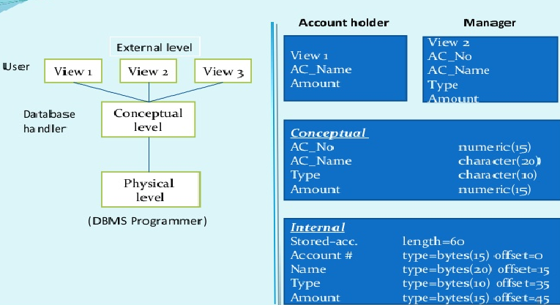
Three levels of data abstraction

Slide 6
DATA MODELS
1. Relational data model
Table : Items Table : Shipments
Table: Suppliers
Item# | Item Name | Price
I1 | Cake | 50.00
I2 | Bread | 09.00
I3 | Biscuits | 06.00
I4 | Snacks | 16.00
Supp# | Item# | Qty-Supplied
S1 | I2 | 20
S1 | I3 | 25
S1 | I4 | 10
S2 | I1 | 05
S2 | I3 | 10
Supp# | Supp-name
S1 | Britannia
S2 | New Bakers
RELATIONAL DATA MODEL: In relational data model, the data is stored in the form of tables (i.e. rows ad columns).
These tables are called relations.
The user of the relational database system may insert new tuples, delete tuples, and modify tuples.

Slide 7
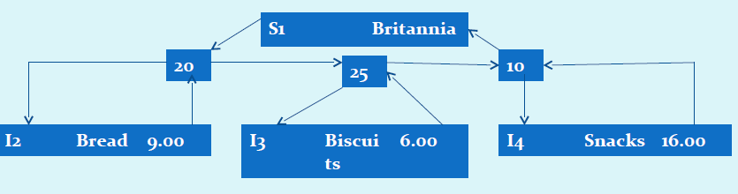
2. Network Data Model
NETWORK DATA MODEL: The network data model differs from the relational model.
In this model data is represented by connection of records and relationships among data are represented by links.
Records are organized as graphs.
This structure called plex structure.

Slide 8
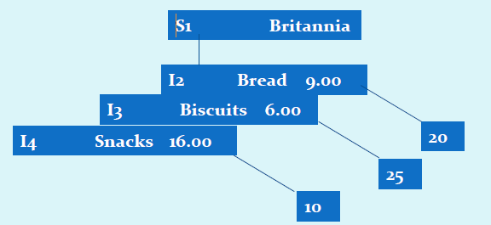
3. Hierarchical Data Model
HIERARCHICAL DATA MODEL: Data is represented by collection of records and relationships among data by links, similar to the network model.
Records are organized as trees rather than graphs.
Represents relationship among its records through parent child relationships.
This structure called tree structure.

Slide 9
Relational Data Model
The relational model was put forward by E.F. Codd of the IBM. It is considered as a very important concept in DBMS.
Some basic terminologies
Relation : A relation is a table i.e. data is arranged in rows and columns.
Tuple : The rows of tables are generally referred to as tuples.
Attributes : The columns of tables are generally referred to as attributes.
Degree : The number of attributes in a relation determine the degree of
the relation.
Cardinality : The number of tuples in a relation is called the cardinality of
the relation.

Slide 10
Views
A view is a (virtual) table that does not really exist in its own right but is instead derived from one or more underlying base tables. It is an excellent way to give people access to some but not all information (data abstraction).
Database Keys are used to establish and identify relations between tables.
Primary key: It is a set of one or more attributes that can uniquely identify the tuples within the relation.
Candidate key : All attribute combinations inside a relation that can serve as a primary key are candidate keys.
Alternate key: A candidate key that is not the primary key is called the alternate key.
Foreign key : A foreign key is a non key attribute whose value is derived from the primary key of another table.

Slide 11


