Slide 1

KANYA MAHAVIDYALAYA KHARKHODA
Presentation of Multithreading
Presented By:
Mrs. Nisha Suhag

Slide 2
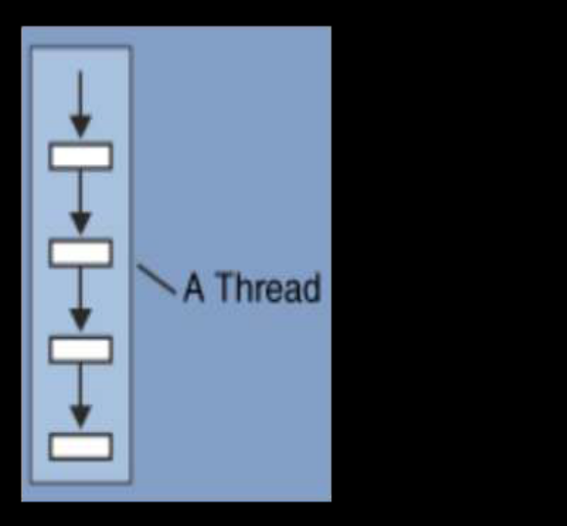
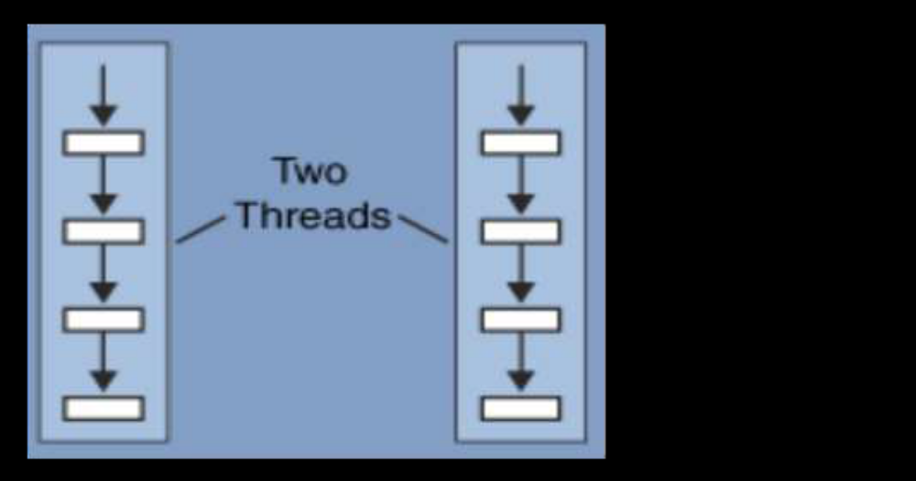
What is Thread?
A thread is a single sequential flow of execution within a program.
A thread is a subset of process.
Thread is considered as “Light Weight Process” because it use less resource than process.
They share the address space of the process but process have their own address space.
JVM create the thread whose task is to define the main thread.

Slide 3
Creation of Thread
You can create a thread in one of the following ways:-
Extending Thread: The first way to create a thread is to create a new class that extends the Thread class and then to create an instance of this class. This class must override the run() method which is the entry point for the new thread.
Implementing Runnable Interface: The easiest way to create a thread is to create a class that implements the Runnable interface. To implement Runnable, a class need only implement a single method called run(). The Format of that function is public void run().
Either of these two approaches may be used. Since multiple inheritance doesn't allow us to extend more than one class at a time, implementing the Runnable interface may help us in this situation.

Slide 4
MULTITHREADING
The process of executing multiple threads simultaneously is known as multithreading.
Example:
Games are very good examples of threading. You can use multiple objects in games like cars, motor bikes, animals, people etc. All these objects are nothing but just threads that run your game application.
In word processor one thread take the input from keyboard and another thread check the spelling mistakes and third thread count the words.
Railway ticket reservation system where multiple customers accessing the server.
Multiple account holders accessing their accounts simultaneously on the server. When you insert a ATM card, it starts a thread for perform your operations.

Slide 5
Advantages of Multithreading
The main advantage is proper utilization or max utilization is possible.
Decreased cost of maintenance.
Time saving.
Improves the performance of complex applications.
Parallelize tasks.

Slide 6
Disadvantage of Multithreading
Complex debugging and testing processes.
Increased difficulty level in writing a program.
Unpredictable results.

Slide 7
Thread Life Cycle
During the life time of a thread, there are many states it can enter. They include:
1. Newborn state
2. Runnable State
3. Running State
4. Blocked State
5. Dead State

Slide 8
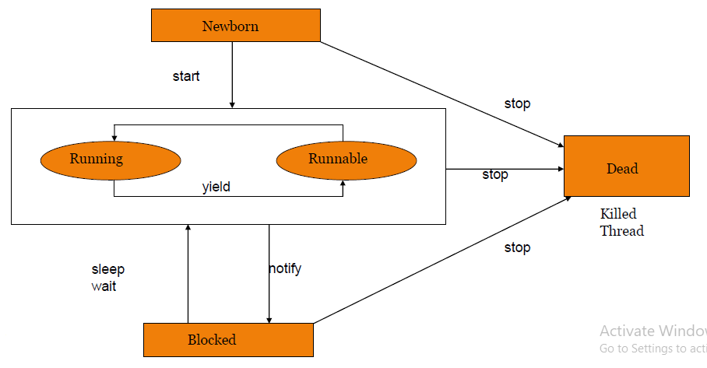
State diagram of a Thread

Slide 9
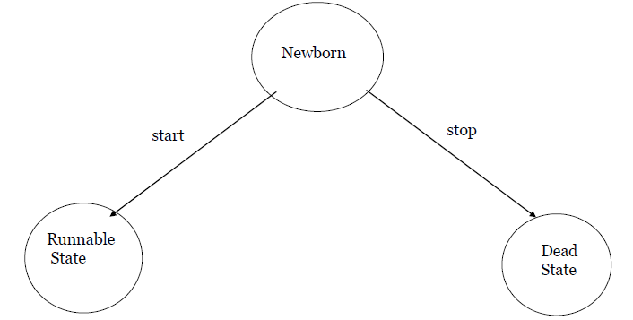
1.Newborn State
When we create a thread object, the thread is born and is said to be in newborn state. The thread is not yet scheduled for running. At this state, we can do only one of the following with it:
Schedule it for running using start() method.
Kill it using stop() method.

Slide 10
2. Runnable state (start())
The runnable state means that the thread is ready for execution and is waiting for the availability of the processor.
That is, the thread has joined the queue of threads that are waiting for execution.
If all threads have equal priority, then they are given time slots for execution in round robin fashion. i.e. first-come, first-serve manner.

Slide 11
3. Running State
Running means that the processor has given its time to the thread for its execution.
The thread runs until it relinquishes control on its own or it is preempted by a higher priority thread.

Slide 12
4. Blocked State
A thread is said to be blocked when it is prevented form entering into the runnable state and subsequently the running state.
This happens when the thread is sleeping, or waiting in order to satisfy certain requirements.
A blocked thread is considered “ not runnable” but not dead and therefore fully qualified to run again.

Slide 13
5. Dead State
A running thread ends its life when is has completed executing its run() method. It is a natural death.
However, we can kill it by sending the stop message to it at any state thus causing a premature death to it.
A thread can be killed as soon it is born, or while it is running, or even when it is in “not runnable” (blocked) condition.

Slide 14
Thread Methods
start() Starts execution of the thread.
stop() Terminates the current thread.
suspend() Suspends the thread.
resume() Restarts the suspended thread.
sleep() This method suspends execution of the executing thread for the specified number of milliseconds. It can throw an interrupted Exception.
getName() Obtains a thread name.
getPriority() Obtain a thread’s priority.
Isalive() Determine if a thread is still running.
wait() Waits for a thread to terminate.
run() Entry point for the Thread.

Slide 15


