Slide 1
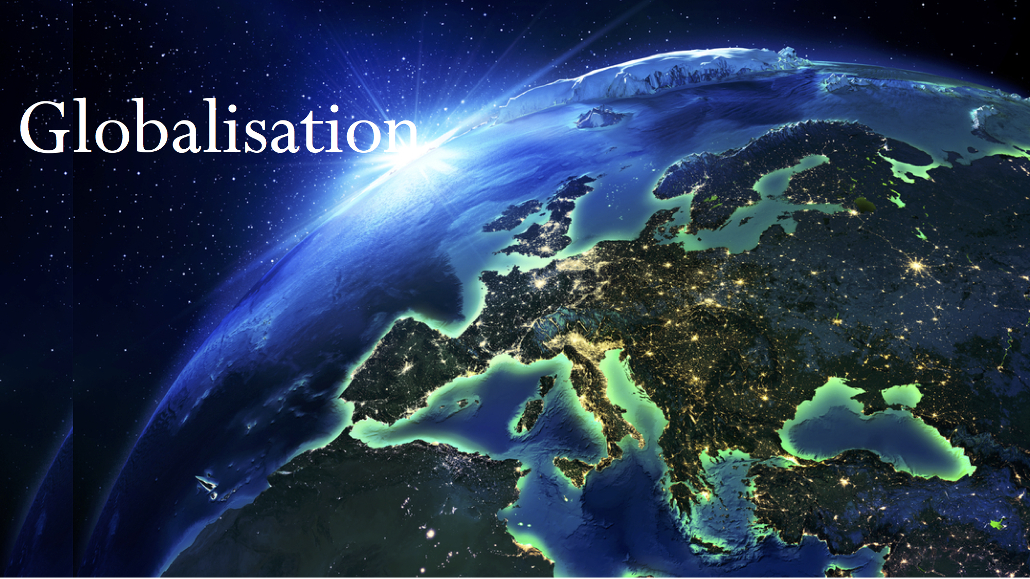
MA (GEOGRAPHY)
FINAL YEAR
PRESENTED BY:
Rekha Dahiya
Assistant Professor
Kanya Mahavidalya, Kharkhoda

Slide 2

INTRODUCTION
The modern world is seen as the world without geographical boundaries and any kind of barriers. Globalisation has been the major force behind this.
Globalisation is the integration of the world economy and exchanging the ideas, products, technologies, etc.
The globalization hit India late but had huge impact on the nation’s economic policies and various other aspects.

Slide 3

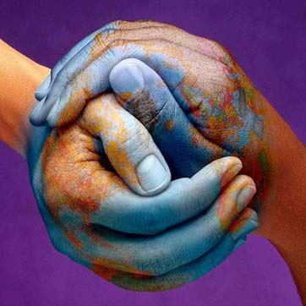
GLOBALISATION
Globalisation is the process of international integration arising from the interchange of the world views, products, ideas and other aspects of culture.
Globalisation means rapid increase in the share of economic activities taking place across national borders.
Today, the economies of most countries are so interconnected that the form part of a single, independent global economy.

Slide 4
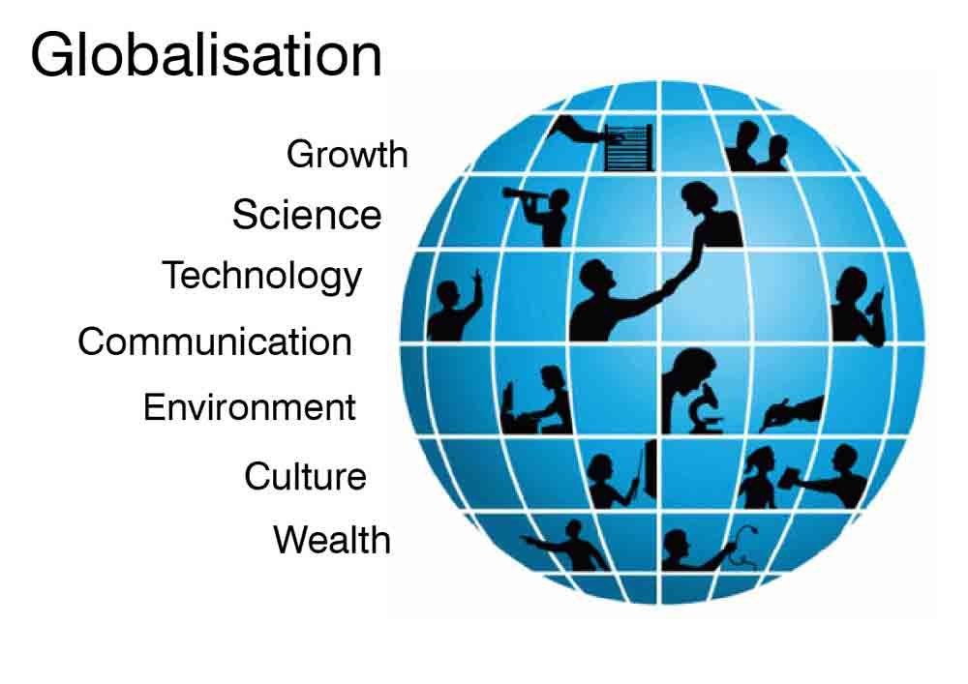
Dimensions of

Slide 5
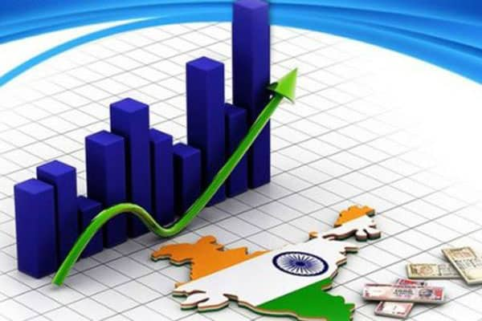
Globalisation of Indian Economy
Indian economy adopted the policy of restriction after the independence.
But in 1991, due to the economic crisis the Government of India decided to open its market for the foreign investments.
The economic policies adopted had impact on every sector of the Indian economy.

Slide 6
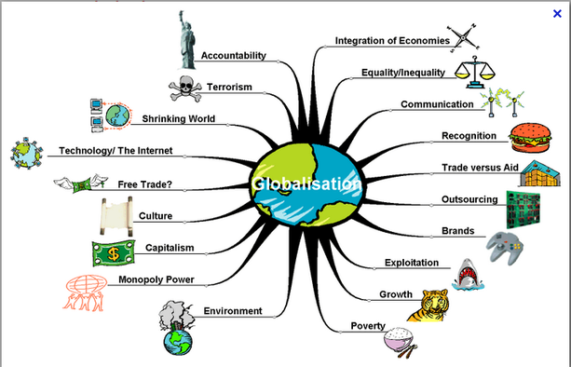
Aspects of Globalisation

Slide 7
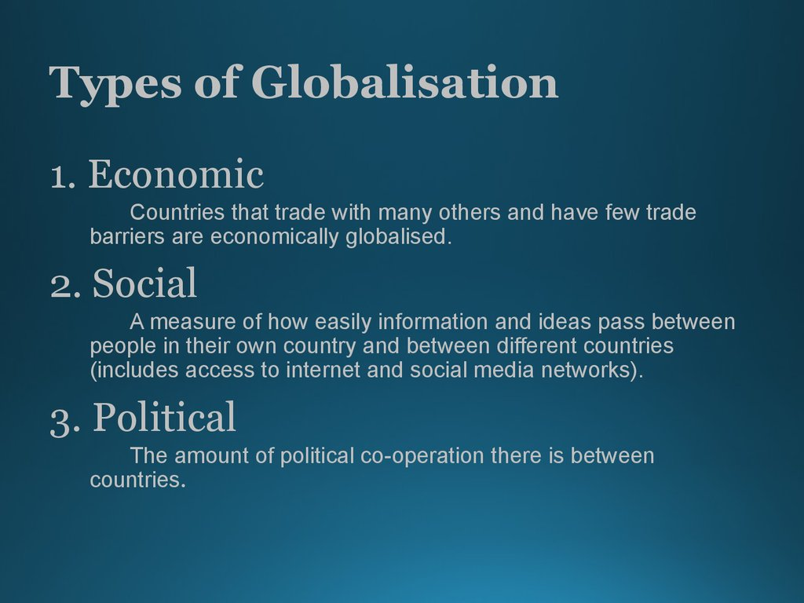


Slide 8
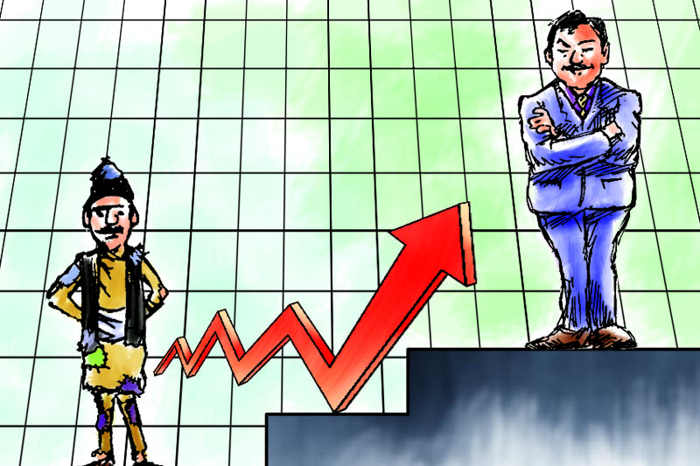

Slide 9

Impact of Globalisation
Rapid growth of business.
Opportunity to go global.
Introduction of various new technologies.
Rise in access of technology in rural areas.
New technology in agriculture.
Literate farmers.
Rise in literacy rate and standard of living.

Slide 10
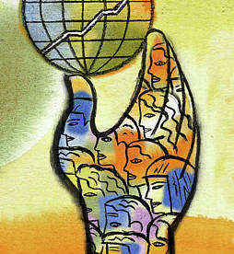
Conclusion
Globalisation has increased the trade of products, ideas, technologies etc. and created the world without boundaries but it also had some negative impact on the developing countries.
Following with globalization, India is shinning in nearly every prospect. India is getting a global recognition and slowly moving towards becoming a major economic and political strength.
Though, the development is progressing rapidly, still many basic problems like rural poverty, corruption and political instability remained unsolved.

